Slide 1
Task 2: Predicting TGLF Results w/ Modeling
Capstone D10, Group 1

Slide 2
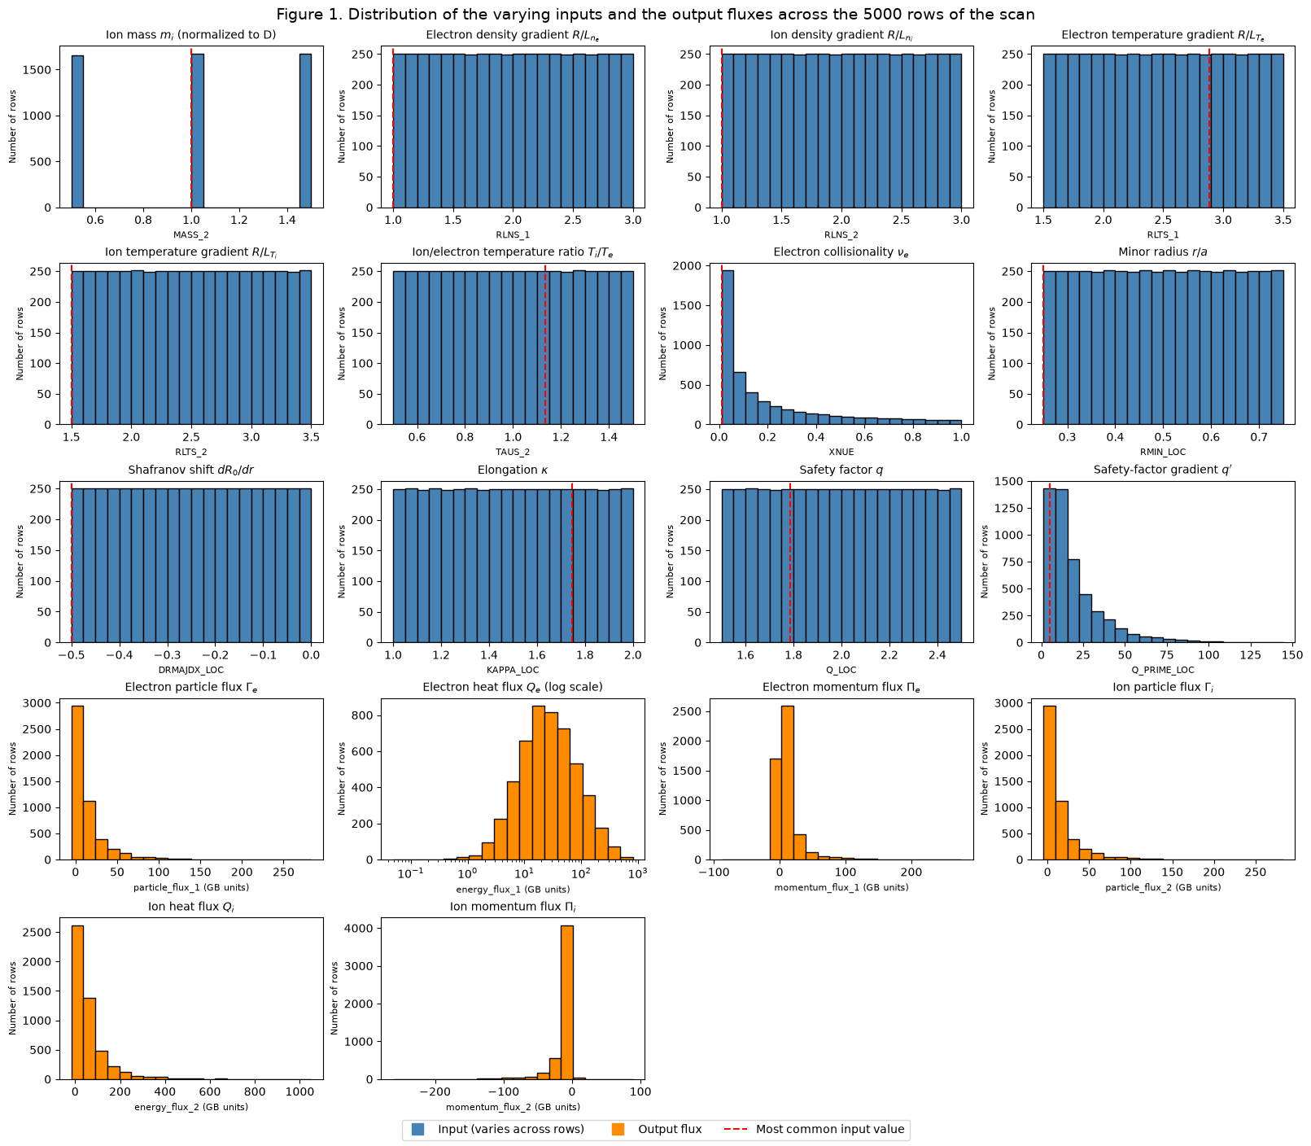
Step 1: Data Loading
Reused Task 1 code logic for data loading & obtained distributions noted to the right
  Expectedly show a flat distribution
  Initial thoughts: many of the output values will need to be log-transformed to have accurate predictions

Slide 3
Step 2: Preprocessing
7 main steps in preprocessing pipeline
Split into train, validation, and test datasets to ensure no data leakage
Remove output columns from the input dataframes
Encode/drop categorical variables
  This included removing non-informative columns, converting boolean to numeric, and using nominal encoding for the object type columns
Remove invalid rows → if any value was NaN/infinite or heat flux <= 0
Remove highly correlated features
Remove low variance features
Scale features via standardization (StandardScaler)

Slide 4
Step 3: Models and Training
Baseline model: linear regressor
Robust models that were tested
  Random forest - decision tree ensemble
  XGBoost - sequential, less complex decision trees
  Neural Network - TGLF-NN inspired MLP
Ran cross-validation tuning to determine optimal parameters
Tested the following:
  Training time and prediction time
  Change in error vs. training test size
  R2 and RMSE values
Finally, retrieved feature importances for Random Forest and XGBoost

Slide 5
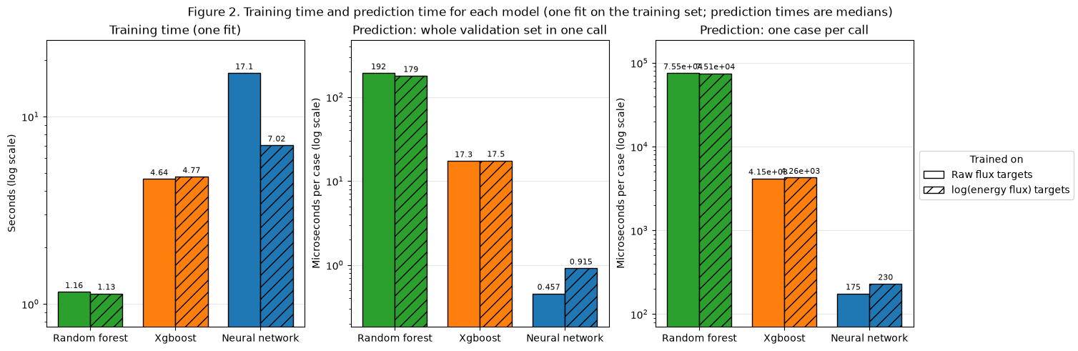

Slide 6
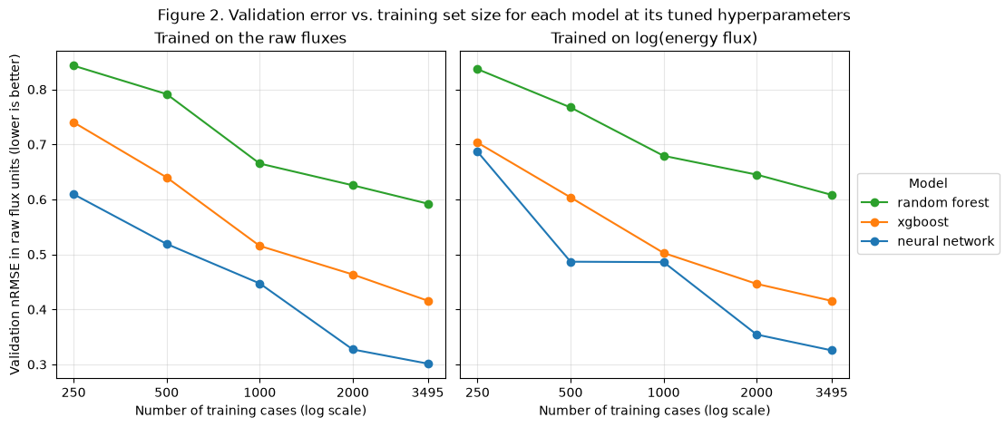

Slide 7
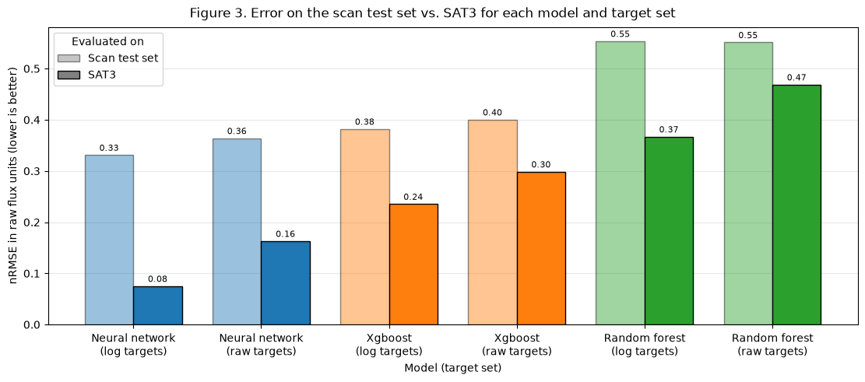

Slide 8
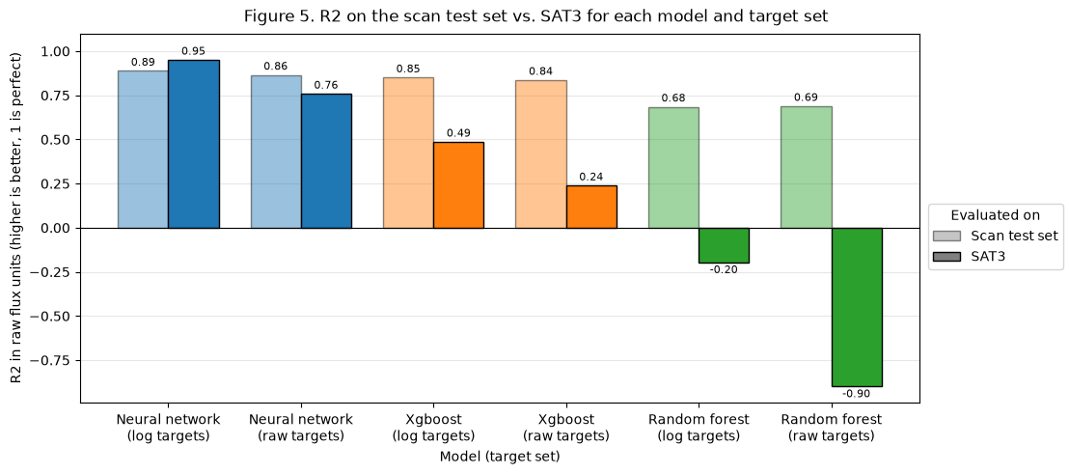

Slide 9
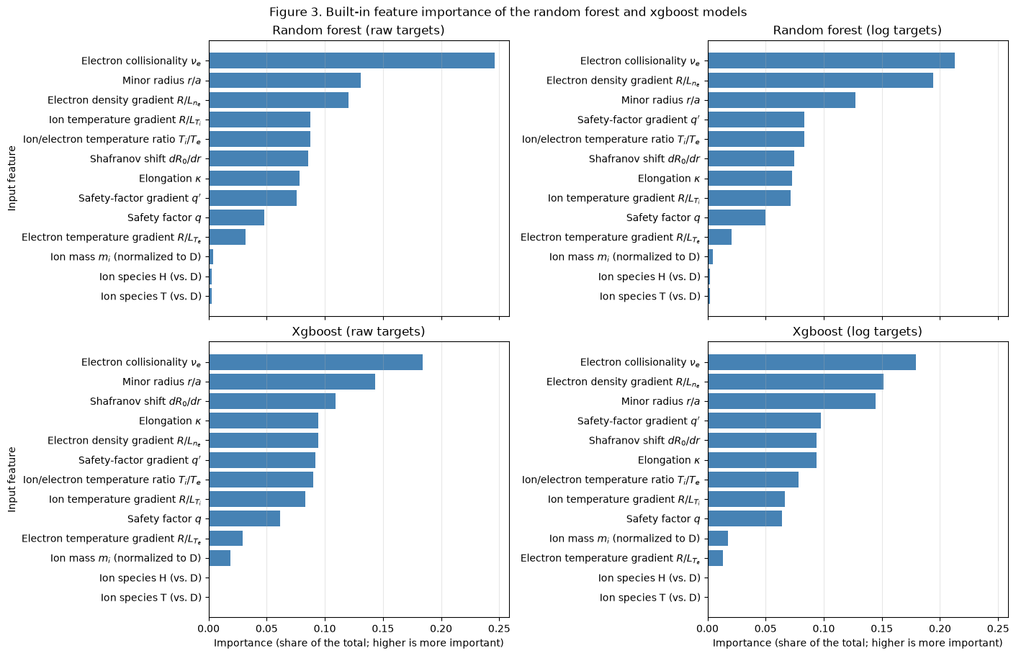

Slide 10
Step 4: Overall Conclusions
Neural networks performed the best (especially when given the unbiased SAT3 test set) but also took the largest amount of training and inference time
Electron collisionality is a consistently important feature
Further areas of exploration
  Making the neural network more efficient
  Removing unimportant features (especially ion species and retraining/testing on fresh data)

